Slide 1

Crafting a Winning Product Strategy for Rapido
By Tejas Borse

Slide 2

Agenda
Introduction: Overview of Rapido and its Market Position
Current Challenges: Regulatory, Market, and Operational Complexities
Market and User Research: Key Insights and Implications
Target Audience: User Segmentation and Personas
Competitor Analysis: Competitor Analysis & Frameworks
Vision and Value Proposition: Product Vision and Goals, Unique Selling Points
Product Strategy: New Features, Product Principles, and Trade-offs
KPIs and Success Metrics: Measuring Impact and Success
Go-To-Market Strategy: Execution Plan, Revenue Streams
Objectives: High Level Goals & Measurable Targets
Conclusion: Key Takeaways and Next Steps

Slide 3

INTRODUCTION

Slide 4
OVERVIEW OF RAPIDO, MISSION & VISION
Company Background:
Founded in the city of Bengaluru in the year 2015, Rapido is India's first and fastest-growing bike taxi app. Today, Rapido operates in over 100 cities across the country, boasting more than 25 million app downloads and completing over 100 million rides.
Service Offerings: Initially known for its bike taxi services, Rapido now offers:
Bike Taxis: The core of our service, providing swift and economical rides.
Auto Rickshaws: Including both Auto and Auto Share options for more flexibility.
Taxis: Catering to different preferences with Premium and Economy options.
Parcel Delivery Services: Ensuring quick and reliable delivery solutions.
Mission and Vision:
Mission: To revolutionize intra-city travel by providing quick, affordable, and convenient transportation solutions.
Vision: To address last-mile connectivity issues and become the preferred choice for urban mobility in India.

Slide 5
DETAILED ANALYSIS OF CURRENT CHALLENGES

Slide 6
PROBLEM STATEMENT
Rapido is a ride hailing service which primarily operates as a bike taxi aggregator. Its offerings also include auto rickshaw and taxicab hailing, parcel delivery, and third-party logistics services ^{[1]}. Rapido expanded into the cab market where giants Uber and its homegrown competitor Ola dominate, and is also looking to integrate intercity bus ticket booking ^{[2]}. The bike taxi industry is plagued by unclear regulations in various states of India and recently 100s of bike taxis were seized in Bangalore in response to protests from auto unions ^{[3]}. Assuming you are the Product Head at Rapido, create a winning strategy for navigating the complex landscape, and use it to define three key new features for the product.

Slide 7
Industry Analysis: Current Challenges
Rapido, while being a pioneer in the bike taxi industry, faces several significant challenges that impact its operations and growth. These challenges span regulatory, market, and operational aspects, creating a complex environment that requires strategic solutions.
Breaking Down Regulatory and Market Complexities
Regulatory Challenges :
Varying state regulations create legal uncertainties and enforcement issues..
Differences in legal status across states complicate compliance efforts
Market Complexities
Intense competition from Uber, Ola, and local services.
User trust and safety concerns due to commercial use of private vehicles.
Operational Challenges
Ensuring that drivers adhere to regulations and maintain valid licenses and insurance.
Maintaining consistent and reliable service amid regulatory and market pressures.

Slide 8
MARKET AND USER RESEARCH

Slide 9
Market Analysis
Market Growth Drivers
Urbanization & Traffic Congestion: Increasing urban population and traffic congestion drive demand for efficient transportation.
Affordable & Convenient: Rising need for cost-effective and quick travel options.
Smartphone Penetration: Easy booking and payment through widespread smartphone use.
Market Opportunities
Technological Advancements: AI, GPS tracking, and real-time monitoring to enhance user experience.
Sustainable Transportation: Shift towards electric vehicles (EVs) for eco-friendly options.
Market Expansion: Growth potential in Tier 2 and Tier 3 cities
Market Size:
Expected to reach $1,478M by 2030, growing at a CAGR of 48.5%

Slide 10





Key Insights From Market Research
Urbanization: Rapid urbanization in India’s Tier I and Tier II cities is driving demand for efficient and cost-effective transport lile bike taxis & ride sharing
Target Market:Rapido primarily serves urban professionals aged 20-40 who value affordability, convenience, and the ability to navigate traffic quickly.
Safety Conscious Riders: A growing segment includes women who prioritize safe & reliable ride sharing over traditional public transports.
Trends: Users prefer on-demand transport that offers guaranteed booking especially in crowded areas during peak hours where they have observed frequent cancellations & surge in prices,
Technology Integrations: Technologies like AI can be utilized in optimizing routes, improve safety, and enhance user experience for better user adoption and retention.

Slide 11
User Research
Objective: Understand user preferences, pain points, and areas for improvement.
Research Methodology:
Surveys: Conducted online surveys with 20+ respondents.
Interviews: In-depth interviews with 10 frequent users.
Online Reviews Analysis: Analyzed 500+ reviews from Google Play Store and social media channels
User Segmentation:
Geographic: Major cities like Bengaluru, Delhi, Mumbai; expansion to Tier 2 and Tier 3 cities.
Demographic: Young professionals, students, daily commuters

Slide 12
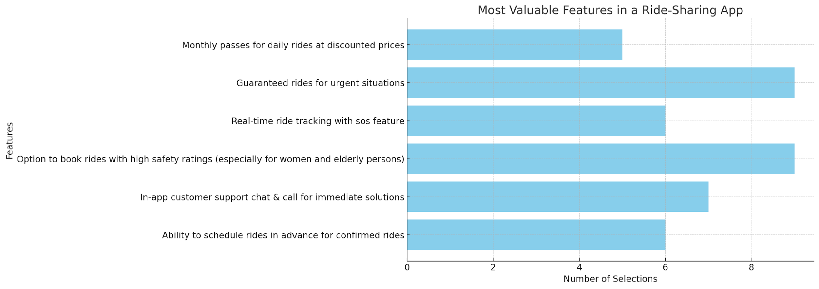
Findings From Primary User Research
Insights gathered from Primary Research: Access Survey Here
Top Valued Features by Users:
High Safety Ratings: Users prioritize the option to book rides with high safety ratings, especially for women and elderly persons.
Guaranteed Rides: Ensuring rides are available in urgent situations is a critical need for users.
In-App Customer Support: Users demand a robust customer support system with chat and call options, highlighting the need for human assistance over ineffective chatbots.
pain

Slide 13
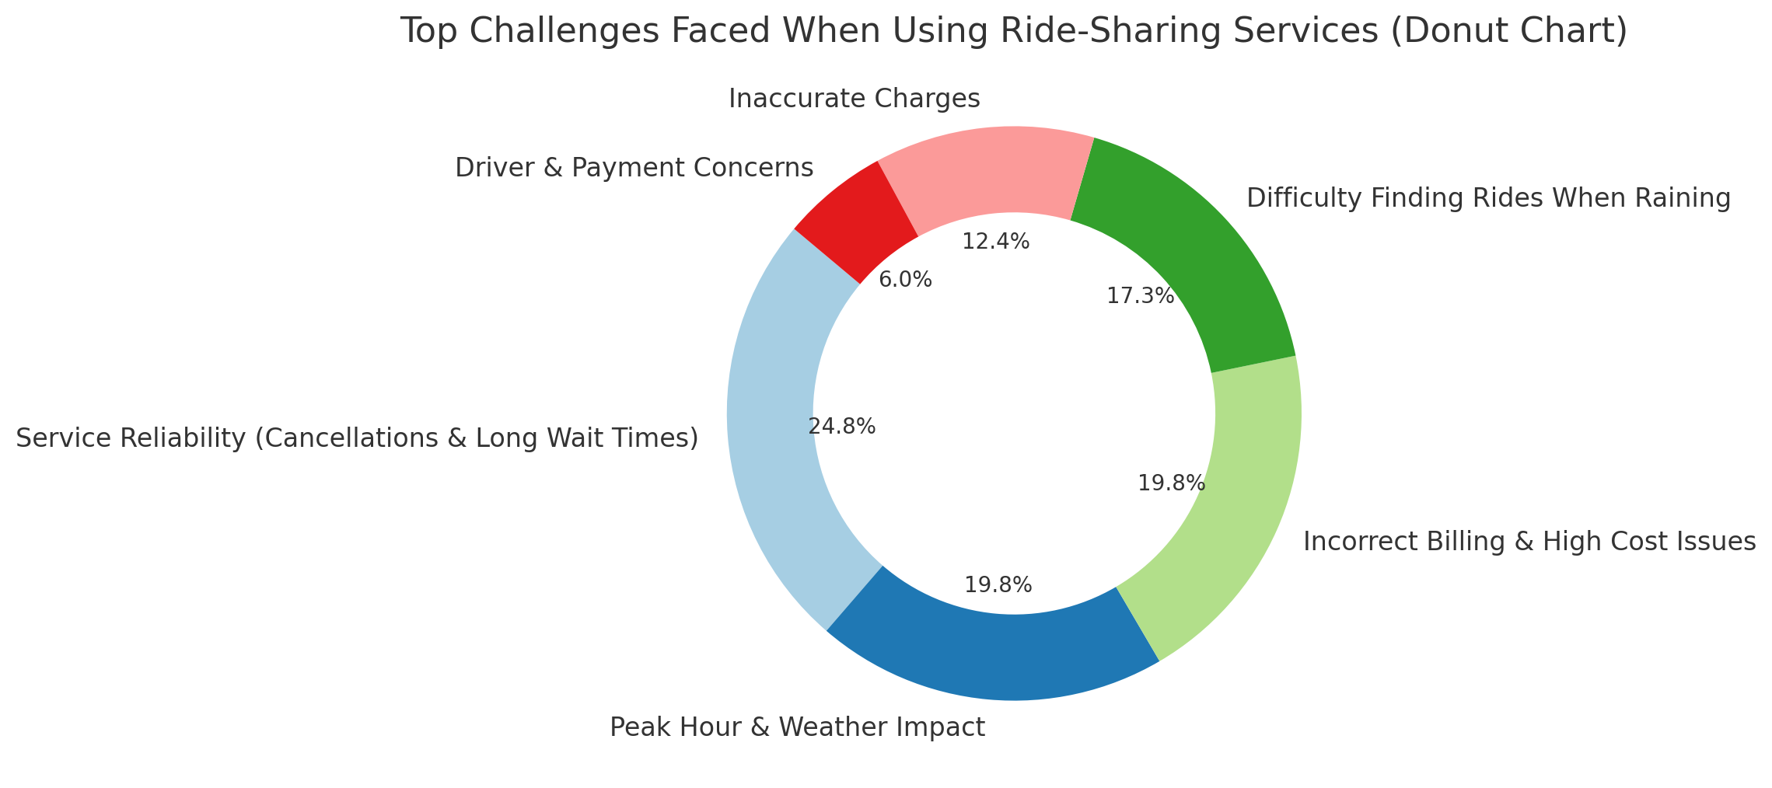
Findings From Primary User Research
Critical Issues Faced by Ride-Sharing Users
🕒 Service Reliability: 24.8% of users face frequent cancellations and long wait times.
⏱️ Peak Hour & Weather Impact: 19.8% struggle during peak hours, and 17.3% during rain.
💸 Cost Issues: 19.8% are concerned about high costs and significant price surges.
📉 Billing Concerns: 12.4% report issues with inaccurate charges.
🚗 Driver & Payment Concerns: 6.0% are troubled by rude or unsafe drivers and being asked to cancel rides for cash.

Slide 14
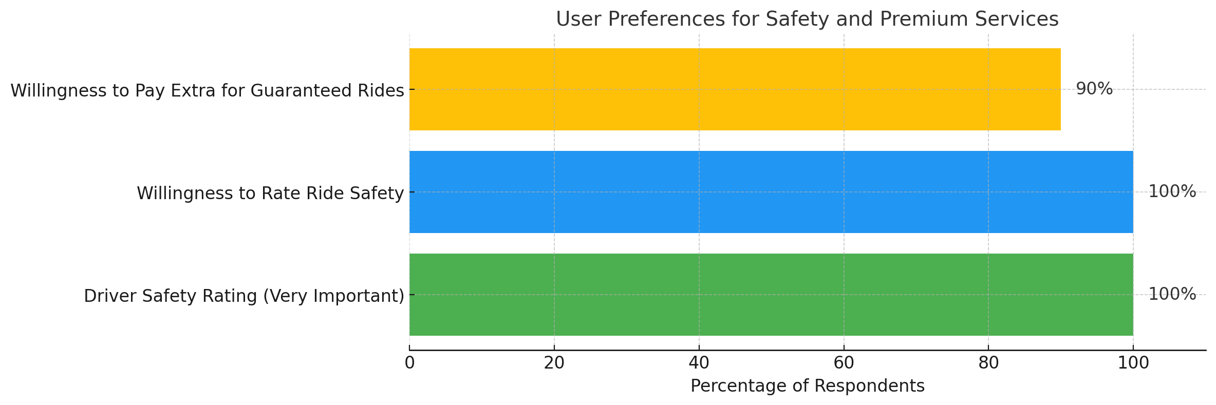
Findings From Primary User Research
Prioritizing Safety and Premium Services
To align our product strategy with user needs, we asked three key questions:
Importance of Driver Safety: 100% of users rated driver safety as "Very Important," highlighting safety as a non-negotiable priority.
Desire for Safety Feedback:100% of users want to rate their ride's safety, showing their commitment to maintaining high standards.
Willingness to Pay for Premium Services: 90% of users are willing to pay extra for guaranteed rides within 10 minutes, signaling strong demand for time-sensitive services.

Slide 15
Key Findings from User Research(Primary)
What Users Value in Their Preferred Ride-Sharing Service
Affordability: Users prioritize cost-effective transportation. It’s a top priority *
Reliability: Quick and easy booking with fewer cancellation is highly valued.
Comfort: Comfortable rides including reliable and clean vehicles with ac is important during longer trips with family/friends.
Pain Points:
Safety Concerns: Ineffective SOS feature, especially among women.
Service Reliability: Frequent cancellations & longer wait times lead to frustration.
High Prices: High prices during peak hours makes commuting less affordable
Customer Support: Users are upset with automated responses and prefer human intervention for quick resolution especially during emergencies with rude drivers
Inaccurate Charges: Several users reported higher billing at the end of trips, which erodes trust in the service.

Slide 16
Key Findings from Secondary User Research
Legal Barriers: Rapido faces legal challenges in states like Karnataka and Maharashtra. Unclear regulations have caused operational disruptions, making it difficult for the company to maintain consistent service​. [1][2]
Auto Union Resistance: In several cities, auto drivers have protested against bike taxis. This has sometimes escalated into hostility, affecting both drivers and passengers.[1]
Tough Competitors: Rapido competes with major players like Uber and Ola. These competitors have a much larger market share, making it challenging for Rapido to stand out​. [2]
Limited Market Share:Despite being an early entrant in the bike-taxi space, Rapido’s market share remains small. This limits its ability to compete effectively against larger rivals​ [2]
Quality Control: Maintaining consistent service quality in Tier II and III cities is challenging for Rapido. Users often report inconsistent experiences, affecting overall satisfaction[3]​
Pressure to Electrify: As part of its expansion, Rapido is under pressure to transition to electric vehicles. This adds complexity to its operations, particularly in smaller cities where infrastructure is limited​ [4]
Rapido launched “Bike Pink” for women users with female captains for increased safety which identifies safety concerns.[5]

Slide 17

Key Findings from Secondary User Research
Reviews collated from Google Play Store
Licensing Problems: Some drivers are operating without proper commercial licenses. This can lead to insurance issues in case of accidents, creating risks for both drivers and passengers​
Offline Ride Requests: Drivers often ask passengers to cancel the app booking and continue offline. This is uncomfortable for users and raises trust issues​
Harassment by Auto Drivers: Passengers, particularly those booking bike taxis, report harassment from auto drivers. This includes intimidation and aggressive behavior & rude treatment from auto drivers, worsening their experience
Reckless Driving: Users have flagged reckless driving by some drivers as a major safety concern. This issue undermines user trust and satisfaction
Insufficient Safety Measures: The current safety measures implemented by Rapido are seen as inadequate by many users. There is a strong demand for more robust protocols​
Ineffective Chatbots: Many users find the chatbot-driven customer support to be ineffective. Issues are often unresolved, leading to frustration and dissatisfaction
Frequent Cancellations: High cancellation rates are a frequent complaint among users. This disrupts their plans and negatively impacts the user experience​
Fair Pricing: High surge pricing during peak hours is a significant issue. Users are calling for more consistent and fair pricing models.

Slide 18
Key Insights from Market and User Research
Regulatory challenges and safety concerns are critical issues that need to be addressed to build user trust and ensure compliance.
Users highly value services offering affordability, speed, and convenience for daily commutes.
Major cities like Bengaluru, Delhi, and Mumbai are key markets, with potential growth in Tier 2 and Tier 3 cities
Expanding market for bike taxis and similar services, with over 25 million app downloads
Significant need for affordable and quick transportation solutions in urban and peri-urban areas.

Slide 19
TARGET AUDIENCE

Slide 20
Defining the Target Audience
Detailed User Profiles
Profile | Age Range | Key Needs | Key Issues
Urban Young Professionals | 22-35 | Quick and affordable transport, minimal wait times. | Safety concerns, regulatory issues.
College Students | 18-25 | Affordable, reliable for daily commutes, available during peak hours. | Limited availability, affordability.
Office Workers | 25-50 | Hassle-free booking, confirmed rides, affordability. | Cancellations, safety, legal clarity.
Safety-Conscious Riders ( esp Women ) | All | Secure, reliable transport with high safety ratings | Rude drivers, need for enhanced safety features
Pet Owners and Families | 25-45 | Pet-friendly and family-friendly transport options | Lack of pet-friendly rides, need for child safety features

Slide 21
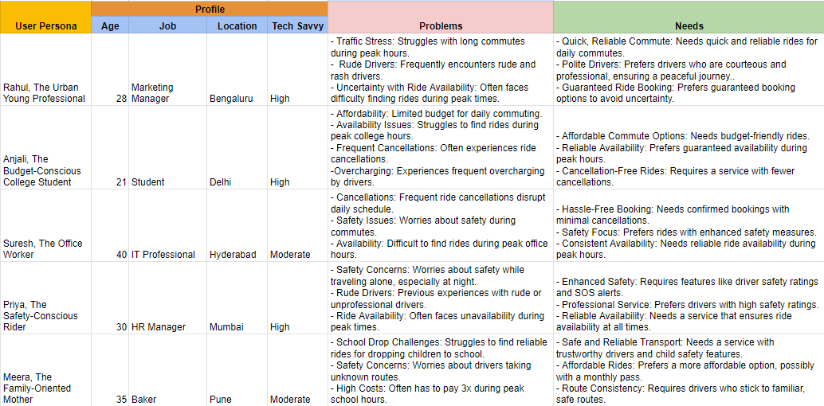
USER PERSONAS

Slide 22
COMPETITOR ANALYSIS

Slide 23
Competitor Analysis
Competitor | Strategy | Positioning
Ola | Wide range of services including cabs, autos, and bike taxis | Comprehensive one-stop transport solution across urban and semi-urban areas in India.
Uber | Focus on premium services and safety | Reliable, premium service provider with a focus on safety, tech integration, and global standards.
Namma Yatri | Localized focus, strong connection with local drivers, has subscription model service which is driver friendly | Community-centric service offering cost-effective solutions tailored to local needs, especially in Tier I and II cities.
BluSmart | Electric cabs, eco-friendly positioning | Eco-friendly alternative with confirmed rides, appealing to environmentally conscious users. & gives confirmed rides
inDrive | Ride-hailing with user-negotiated pricing model | Fair-price, user-driven service that allows passengers to negotiate ride fares directly with drivers, positioning itself as a transparent and flexible alternative in the market

Slide 24
SWOT ANALYSIS
S
W
O
T
Strengths
Weaknesses
Opportunities
Threats
Strong market presence with 25M+ downloads
Affordable and quick transportation
Localized focus with a strong network in Tier II and III cities
- Regulatory challenges in different states
- Safety concerns with bike taxis
- Customer support issues, particularly with ineffective chatbots
Expansion into Tier 2 and Tier 3 cities
-Introduction of new services like intercity bus booking and pet-friendly rides
- Partnerships for EV adoption to stay ahead in the eco-friendly segment
Intense competition from well-established players
Harassment from local auto drivers
- Technological disruptions from competitors offering advanced AI-based safety services
Notes:
© Copyright PresentationGO.com – The free PowerPoint and Google Slides template library

Slide 25









Porter Five Forces Analysis
Bargaining Power of Customers
HIGH
Customers have multiple options to choose from
Price sensitivity is a major factor, which prompts users to try other apps
Threat of Substitutes
MEDIUM
Alternative transports like cabs, autos, and public transport like metro a moderate threat.
Threat of New Entrants
LOW
Barriers to entry include regulatory challenges and high initial investment costs.
Bargaining Power of Suppliers
MEDIUM
Multiple suppliers for bikes and maintenance services. However, any significant changes in fuel prices or vehicle maintenance costs could impact operational expenses.
Competitive Rivalry
HIGH
Presence of multiple strong competitors like Ola, Uber, and local services
Companies are competing on price, service quality, safety, and technological innovation

Slide 26
JOBS TO BE DONE
Job | When | Goal | Outcome
Book a Quick Ride | Users need to reach their destination swiftly, especially during peak hours or in emergencies. | To book a ride instantly and reduce travel time through congested areas. | Arrive at the destination on time, minimizing delays and stress.
Ensure Safety During Rides | Users feel concerned about their safety, especially during late hours or when traveling alone. | To ride with a highly rated driver and track the ride in real-time. | Feel secure and confident throughout the journey, with peace of mind for themselves and their loved ones.
Schedule Rides in Advance | Users have a planned trip, like catching a flight or attending an important event. | To schedule a ride ahead of time and guarantee punctuality. | Arrive punctually at the destination, with the assurance that the ride is confirmed and reliable.
Avoid High Costs During Peak Times | Users need to travel during peak hours but want to avoid surge pricing. | To find an affordable ride option that doesn’t break the bank. | Save money while still reaching the destination on time, without worrying about exorbitant surge prices.
Access Reliable Customer Support | Users encounter issues with their ride, such as cancellations or driver behavior. | To quickly contact a helpful customer support representative for resolution. | Resolve ride issues swiftly, ensuring a smooth and hassle-free experience.
Get Pet-Friendly Rides | Users are traveling with pets and need a service that accommodates them. | To book a ride that allows pets, ensuring comfort for both the user and the pet. | Enjoy a stress-free ride with pets, knowing that the service accommodates their specific needs.
Book a Safe Ride for Loved Ones | Users need to book a ride for someone else, like a family member or friend. | To ensure that the ride is safe and that the driver is reliable. | Feel assured that loved ones are in safe hands, with the ability to monitor the ride remotely.
Handle Ride Cancellations Efficiently | Users face frequent ride cancellations and need to quickly find an alternative. | To rebook a ride quickly without hassle. | Minimize delays and frustration by securing a new ride swiftly, reducing the impact of cancellations.
Receive Ride Notifications | Users are busy and need timely reminders for their scheduled rides. | To get notifications for upcoming rides or changes to the booking. | Stay informed and on schedule with timely updates, reducing the chances of missing or delaying the ride.

Slide 27
ARTICULATING THE VALUE PROPOSITION

Slide 28
Product Vision: Future of Urban Mobility
Vision Statement: To be the most trusted and preferred urban mobility platform in India, offering seamless, safe, and affordable ride-sharing solutions that cater to the diverse needs of our users, while pioneering sustainable and innovative transportation options.
Core Principles:
User-Centric Experience: Deliver unparalleled convenience and reliability, ensuring every ride meets our users' safety, affordability, and efficiency expectations.
Safety First: Commit to the highest safety standards through continuous innovation in driver safety features, real-time monitoring, and proactive customer support.
Inclusivity & Accessibility: Ensure our services are accessible to all users, regardless of their economic background, by providing flexible pricing models and a lightweight, user-friendly app.
Long-Term Aspirations:
To expand Rapido’s presence across every major city in India, becoming synonymous with dependable urban mobility.
To build a robust ecosystem that integrates multiple transportation modes, including bikes, autos, and cabs creating a one-stop solution for all urban commuters.
To continually leverage cutting-edge technology, such as AI and machine learning, to enhance route optimization, driver safety, and personalized user experiences.
To foster strong partnerships with local governments and communities, advocating for safe, sustainable, and regulated urban transportation systems.

Slide 29
Core Value Proposition
Rapido is the only ride-sharing service in India that offers a comprehensive focus on quick bike taxi solutions. Perfect for urban commuters, it allows users to swiftly navigate through city traffic without the usual delays of traditional transport
Why Rapido Stands Out:
Quick Rides: Navigate city traffic fast with our bike taxi solutions.
Safety First: Ride with confidence, thanks to real-time tracking and advanced safety protocols.
Affordable Options: Get cost-effective transport without compromising quality. Perfect for daily commutes.
What Sets Rapido Apart:
Driver Incentives: We reward drivers for waiting, ensuring they stay at the pickup point and reducing cancellations.
Better for Everyone: Drivers are happier, and riders reach on time—no delays, no penalties, lesser cancellations.
Satisfaction Guaranteed: From booking to drop-off, we’re committed to making every ride smooth and reliable
.

Slide 30
KEY DIFFERENTIATORS
Unique Selling Point | Description
Affordability | Rapido offers highly competitive pricing, making it an affordable option for daily commuters and budget-conscious users.
Quick and Convenient Rides | With a focus on quick availability and minimal wait times, Rapido ensures a convenient and time-saving transportation option
Wide Range of Services | In addition to bike taxis, Rapido offers autos, cabs, and parcel delivery services, catering to diverse transportation needs.
Driver Incentives for Waiting | Rapido incentivizes drivers for waiting, promoting a sympathetic and supportive community among drivers, which enhances the overall user experience and reducing cancellations after reaching pickup point.
Safety and Security | Rapido prioritizes rider safety with advanced safety protocols and real-time tracking, ensuring a secure journey every time.
User Convenience | Rapido’s user-friendly app offers features like advance booking and driver selection, providing a seamless and personalized ride experience.

Slide 31
FORMULATING THE PRODUCT STRATEGY

Slide 32
PRODUCT PRINCIPLES
User-Centric Safety
Real-Time Monitoring: Continuously track rides and alert users to potential safety concerns.
Safety Driver Feature: Implement a driver safety rating system that is visible before booking and can be rated after each trip, enhancing trust.
Route Safety Protocols: Trigger alerts and check-ins if the drop location differs with immediate access to emergency support.
Flexible Ride Options
Quick Rides: Offer immediate & confirmed booking for those in a rush.
Affordable Alternatives: Allow users to choose cost-effective options with slight wait times.
Driver Empowerment
Incentives for Wait Times: Reward drivers for waiting,& for minimal cancelling encouraging better service.
Community Focus: Promote a supportive environment for drivers, leading to higher service quality.
Technological Innovation
Smart Booking Suggestions: Use past ride data to suggest the best times to book and show nearby vehicles for regular routes.
Safety Alerts: Notify users if their ride is stationary for too long or if there’s an unexpected route change.
Enhanced Customer Support
In-App Support and Call Feature: Integrate in-app customer support with a call option for immediate assistance, addressing a major concern in both app reviews and surveys.
Advanced SOS Features: Improve the SOS feature by integrating in-app customer support and an emergency call option for immediate assistance
Operational Efficiency
User-Friendly Design: Ensure the app is easy to navigate and efficient in its operations.
Optimized Performance: Maintain a balance between simplicity and robust features to enhance the user experience.

Slide 33
TRADE OFFS
Balancing key priorities in our product strategy involves trade-offs to ensure safety, support, and innovation while maintaining a user-friendly experience
1. Safety vs. Costs
Decision: Prioritize safety features like real-time monitoring and driver safety ratings.
Trade-Off: Higher operational costs, but ensures user trust and long-term loyalty.
2. Support vs. Features
Decision: Enhance customer support with in-app help and emergency call options.
Trade-Off: Slower introduction of complex features to maintain an intuitive interface.
3. Quick Rides vs. Affordability
Decision: Provide instant ride options for urgent needs
Trade-Off: Premium pricing for immediate availability, balanced by affordable shared options for cost-sensitive users.
4. Innovation vs. Growth
Decision: Invest in AI and predictive analytics to enhance safety and user experience.
Trade-Off: Slower expansion in other areas like marketing or new markets.

Slide 34
MVP [Proposing New Features]
Feature | Key Features | Business Justification | Impact Expected
Guaranteed Ride Booking with Dynamic Pricing | Guaranteed ride booking within 10 minutes Advanced Booking Discounts Dynamic Pricing During High Demand | Enhanced Reliability Increased Revenue Increased Driver Motivation Lesser Cancellations | Improved User Satisfaction Higher Ride Volume Increased Driver Engagement
Driver Safety Feedback & Rating System | Driver safety ratings visible before booking. Option for users to rate safety after every trip Incentives for drivers with high safety ratings | Enhanced Trust Enhances overall service quality. Encourages better driver behavior and service. | Higher user trust and retention Increased Ride Bookings Reduced incidents and complaints.
SmartCommute Notifications with AI-Driven Suggestions | AI-Driven Ride Suggestions Notifications for optimal booking times. Personalized alerts for nearby vehicles. | Enhanced User Experience Market Differentiation Increases ride booking | Higher User Engagement Increased Ride Bookings Enhanced user satisfaction
Enhanced In-App Customer Support & Advanced SOS & Safety Alerts | 24/7 in-app chat support. Emergency call option for real-time assistance AI-powered support for quicker response times. | Improved User Trust and Loyalty Reduces resolution time and enhances user experience | Higher Retention Rates Higher customer satisfaction Enhanced brand loyalty
Flexible Ride Options | Immediate booking for users in a rush. Slight wait time for cost-effective options. Option to choose between quick and affordable rides when booking | Aligns with diverse user needs for speed or affordability.Increases user choice and control over their ride experience.Balances demand across different service tiers. | Higher user satisfaction and retention.Increased ride bookings in both categories.Optimized service efficienc

Slide 35
Hypotheses to be Tested
Hypothesis | Hypothesis Description | Test | Success Metric
Guaranteed Ride Booking Hypothesis | Users will pay extra for rides that arrive within 10 minutes. | Track how many users choose guaranteed booking. | 70% of users opt for guaranteed booking; satisfaction score ≥ 4.5/5
Driver Safety Feedback Hypothesis | Users feel safer and are more likely to reuse the service when they can rate drivers. | Monitor how often users rate driver safety. | 80% of users rate driver safety; 10% increase in repeat bookings
Enhanced Customer Support Hypothesis | Real-time in-app support will improve complaint resolution and user satisfaction. | Measure response time and resolution efficiency. | 50% faster resolution; satisfaction score ≥ 4.5/5
SmartCommute Notifications Hypothesis | Personalized ride suggestions will increase user engagement and bookings. | Count how many users interact with notifications. | 60% engage with notifications; 15% increase in ride bookings
Flexible Ride Options Hypothesis | Offering quick and affordable rides will boost bookings and satisfaction. | Track user choices between quick and affordable rides. | 30% choose quick rides; 50% choose affordable rides; satisfaction ≥ 4.2/5

Slide 36
Key Success Metrics
Quick Ride Bookings
Metric: Percentage of users booking quick rides
Target: Achieve 70% selection during peak hours
Driver Safety Ratings
Metric: Percentage of trips with safety ratings
Target: Secure 80% rating submission, leading to increased loyalty
Support Response Time
Metric: Average time to resolve support queries
Target: Shorten the current resolution time by 50%, boosting user satisfaction
Notification Engagement
Metric: Percentage of users interacting with ride alerts
Target: Reach 60% engagement, driving higher booking rates
Ride Option Selection
Metric: Distribution of quick vs. cost-effective ride choices
Target: 30% quick rides, 50% cost-effective, both maintaining high satisfaction levels
Safety Issue Reduction
Metric: Reduction in reported safety issues
Target: 80% decrease in incidents, with a corresponding increase in user trust

Slide 37
GO-TO-MARKET STRATEGY

Slide 38
Go-To-Market Strategy
Business Model and Revenue Streams
Revenue Streams:
Ride Commissions: Earned on each ride booked through the platform.
Monthly Pass Subscriptions: Paid subscriptions for frequent users offering discounts and exclusive benefits.
Guaranteed Ride Premium: Users pay an additional fee for priority ride booking, ensuring a faster pickup time
Advertising: Revenue generated from in-app advertisements and partnerships.
Business Model:
Subscription-Based Model: Offer monthly passes to frequent users with benefits such as discounted rides and exclusive features.
On-Demand Premium Service: Introduce a guaranteed ride booking feature that allows users to pay extra for immediate or priority pickups, bypassing the need for tipping for faster service.

Slide 39
Go-To-Market Strategy
Market Research and Analysis
Identify Target Audience: Focus on urban commuters, particularly working professionals aged 20-40 who value quick, affordable, and reliable transportation.
Competitor Analysis: Assess competitors like Ola, Uber, and Namma Yatri to understand their strengths, weaknesses, and market positioning.
User Needs Assessment: Gather insights through surveys and interviews to understand what users value most in ride-sharing services, such as safety, convenience, and affordability.
Value Proposition and USP
Core Value Proposition: Emphasize Rapido's commitment to quick, safe, and affordable rides, with unique features like driver safety ratings and guaranteed ride bookings.
USP: Focus on the benefits of using Rapido, such as reliable service, enhanced safety features, and cost-effective transportation options.
Brand Identity: Develop a brand image that resonates with professionalism, trust, and innovation in the urban transportation sector.

Slide 40
Go-To-Market Strategy
Product Development and Launch
MVP Development: Prioritize essential features like guaranteed ride bookings, driver safety feedback, and enhanced customer support for the initial launch.
Beta Testing: Conduct a beta test with a select group of users to gather feedback and make necessary adjustments before the full launch.
Launch Readiness: Ensure the app is fully functional, secure, and user-friendly, with all key features thoroughly tested and optimized.

Slide 41
Go-To-Market Strategy
Distribution, Sales Channels, and Marketing
Channels:
Mobile App: The primary platform for user interaction, including booking rides, making payments, and accessing customer support.
Partnerships with Local Businesses: Collaborate with local businesses to offer discounts, subscription packages, and other promotions.
Digital Marketing: Utilize SEO, content marketing, social media, and influencer partnerships to drive user acquisition.
Marketing Campaigns:
Targeted Campaigns: Highlight unique features, safety measures, and affordability to attract specific user segments.
Public Relations: Issue press releases and seek media coverage to build brand visibility.
Corporate Partnerships:
Partner with companies to offer the app as part of their employee transportation programs.
Provide bulk subscription packages and special discounts for corporate clients.

Slide 42
Go-To-Market Strategy
Customer Engagement and Retention
Onboarding Process:
Create a seamless and informative onboarding experience to help new users quickly navigate the app and access its features.
Provide a welcome package that includes tips for getting started and making the most of the app’s features.
Continuous Improvement:
Regularly update the app based on user feedback and technological advancements
Introduce new features to keep users engaged.
Customer Support:
Provide robust customer support with in-app chat, call options, and a dedicated SOS feature for emergencies.
Community Building:
Foster a sense of community among users through features like ride-sharing forums and driver appreciation programs.

Slide 43
Go-To-Market Strategy
Metrics and Analytics
KPIs:
Track key performance indicators like user acquisition, retention rates, and session frequency to measure the success of your GTM strategy.
Monitor latest app store rankings, reviews, and ratings after launch
User Feedback: Regularly collect user feedback through surveys, in-app prompts, and focus groups to understand user needs and improve the app.
Data-Driven Decisions:
Use analytics tools to gather insights on user behavior and engagement.
Make data-driven decisions to enhance user experience and optimize marketing strategies.

Slide 44
HIGH-LEVEL GOALS AND MEASURABLE TARGETS

Slide 45

Objectives: High-Level Goals and Measurable Targets
High-Level Goals
Regulatory Adaptation
Target: Achieve 100% compliance with local and state regulations across all operational regions.
Measure: No service interruptions due to regulatory issues within the next year.
Market Differentiation
Target: Increase market share by 15% in Tier 2 and Tier 3 cities within the next 12 months.
Measure: Introduction of 2-3 unique features that competitors don’t offer, driving user preference.
Enhanced User Experience
Target: Boost user satisfaction scores to 4.5/5 or higher on all major app stores.
Measure: Implement and track the adoption of new safety and customer support features.
Service Expansion
Target: Expand into 50 new cities, focusing on Tier 2 and Tier 3 markets, within the next year.
Measure: Successfully launch intercity travel and third-party services, achieving 20% of revenue from these new offerings.

Slide 46

Objectives: High-Level Goals and Measurable Targets
Measurable Targets
Regulatory Compliance: No operational downtimes due to regulatory non-compliance, with proactive adaptations based on regulatory trend analysis.
Market Growth: According to Statista, the ride-sharing market in India is expected to grow by X% annually, with Tier 2 and Tier 3 cities leading this growth. Rapido aims to capture 15% of this expanding market by introducing features tailored to these regions.
User Preferences: Statista reports that 70% of ride-sharing users prioritize safety and cost-effectiveness. Rapido's focus on Driver Safety Ratings and Flexible Ride Options directly addresses these user demands.
Competitor Analysis: Competitor analysis from Statista reveals a market gap in guaranteed ride bookings, which Rapido will fill with its Guaranteed Ride Booking feature, targeting an additional 15% market share
User Satisfaction: Achieve a 4.5/5 rating on app stores, with improvements informed by user feedback and competitor analysis.
Expansion Success: Generate 20% of total revenue from new intercity and third-party services, with targeted expansion based on Statista’s demographic and economic data.

Slide 47
Conclusion & Next Steps
Key Insights:
Comprehensive analysis of market trends and user needs has shaped our strategy.
Identification of critical pain points for our target audience ensures that our solutions are user-centric.
Competitive landscape review highlights opportunities for differentiation and innovation.
Strategic Decisions:
Safety First: Prioritize features like Driver Safety Ratings and Advanced SOS Alerts to enhance trust and user satisfaction.
Flexibility & Affordability: Focus on offering Flexible Ride Options to cater to diverse user needs.
Tech-Driven Growth: Implement AI-driven SmartCommute Notifications and lightweight app design to improve user experience and engagement.
Next Steps:
MVP Rollout: Begin development and testing of MVP features, focusing on guaranteed ride booking and safety enhancements.
Regulatory Alignment: Continue engaging with regulatory bodies to ensure compliance and sustainable growth.
Marketing Launch: Prepare for a targeted marketing campaign emphasizing safety, reliability, and affordability.

